Slide 1

ECE 2700
Digital Circuits
Finite State Machines
(FSMs)
Copyright © 2010 Frank Vahid
Instructors of courses requiring Vahid's Digital Design textbook (published by John Wiley and Sons) have permission to modify and use these slides for customary course-related activities, subject to keeping this copyright notice in place and unmodified. These slides may be posted as unanimated pdf versions on publicly-accessible course websites.. PowerPoint source (or pdf with animations) may not be posted to publicly-accessible websites, but may be posted for students on internal protected sites or distributed directly to students by other electronic means. Instructors may make printouts of the slides available to students for a reasonable photocopying charge, without incurring royalties. Any other use requires explicit permission. Instructors may obtain PowerPoint source or obtain special use permissions from Wiley – see http://www.ddvahid.com for information.

Slide 2
Today’s Objectives
To understand what a finite state machine (FSM) is
To understand how to use an FSM to describe a sequential circuit

Slide 3
Designing Sequential Circuits
Now that we have registers, we can build sequential circuits
  Key concept is state
Back to our previous example
  Turning on/off your computer
Let have a one-bit register (i.e., a flip-flop) hold the current state of the computer
On/off button pressed
Computer is on
Computer is off
On/off button pressed

Slide 4

Turning Computer On/Off
new_s
button
Button | curr_s | new_s
0 | 0 | 0
0 | 1 | 1
1 | 0 | 1
1 | 1 | 0
1-bit
reg
curr_s
combinational circuit
curr_s button
new_s
We’ve just built our first sequential circuit!!!

Slide 5
Designing Good Sequential Circuits
Ad-hoc design process is not efficient/sufficient
  How create other sequential circuits?
Need
  A way to capture desired sequential behavior
    Today
  A way to convert such behavior to a sequential circuit
    Later

Slide 6
Finite State Machines (FSMs)
Describe desired behavior of sequential circuit
  Akin to Boolean equations for combinational behavior
List
  Inputs and outputs
  States
  Initial State
  Transitions (be sure to consider all cases)
Example: a cashier at a grocery store

Slide 7
FSM Definition
FSM consists of
  Set of states
    Ex: {Off, On1, On2, On3}
  Set of inputs, set of outputs
    Ex: Inputs: {b}, Outputs: {x}
  Initial state
    Ex: “Off”
  Set of transitions
    Each with condition
    Describes next states
    Ex: Has 5 transitions
  Set of actions
    Sets outputs in each state
    Ex: x=0, x=1, x=1, and x=1
Inputs: b; Outputs: x
x=0
Off
b
’
b
x=1
x=1
x=1
On1
On2
On3
We often draw FSM graphically, known as state diagram
Can also use table (state table), or textual languages

Slide 8
Question (AP)
Given the following FSM, what are the output(s)?
  w
  z
  w and z
  None of the above
  ☹
z=0
Off
w=1
z=0
w=0
z=0
First 1
w=0
First 0
w=1
w=0
w=1
z=1
Sec 1
w=0
w=1
w=1
Sec 0
z=1
w=0

Slide 9
Steps for FSM Construction
List states
  A state for each possible situation
  Give meaningful names, show initial state
Create transitions
  For each state, define all possible transitions leaving that state
  FSM can only be in one state at a time
Refine the FSM
  Execute the FSM mentally and make any needed improvements

Slide 10
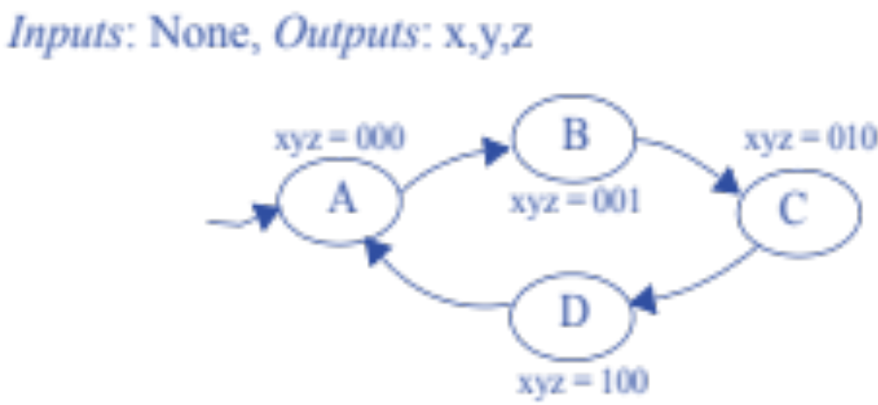
FSM Example
Input
  Clk
Outputs
  x, y, and z
Behavior
  Displays the following sequence
    000, 001, 010, 100, and repeat
  Output only changes on a rising clock edge
  000 is the initial state
Clk^
Clk^
Clk^
Clk^

Slide 11
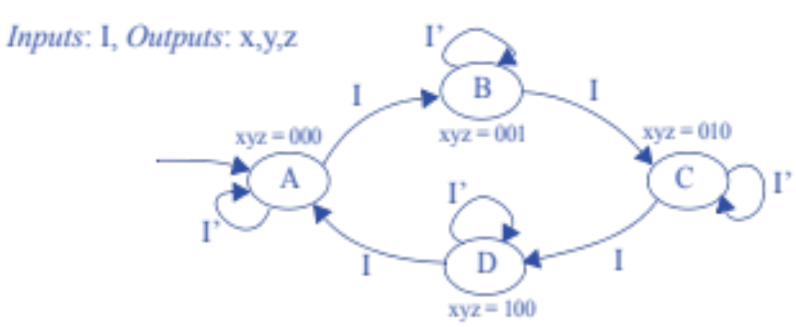
Question (AP)
What does I do in the following FSM?
  Stops state transitions when I = 1
  Stops state transitions when I = 0
  Nothing
  Not enough information to determine
  ☹

Slide 12
Question (AP)
Given the following FSM and input sequence w = {111010}, what is the last state in the FSM?
  Off
  First 1
  Second 1
  First 0
  Second 0
z=0
Off
w=1
z=0
w=0
z=0
First 1
w=0
First 0
w=1
w=0
w=1
z=1
Sec 1
w=0
w=1
w=1
Sec 0
z=1
w=0

Slide 13
FSM Simplification
Rising clock edges implicit
What if we wanted a transition without a rising edge
  We don’t consider such asynchronous FSMs
    Less common and advanced topic
  Only consider synchronous FSMs – rising edge on every transition
Clk^
Clk^
Clk^
Clk^

Slide 14
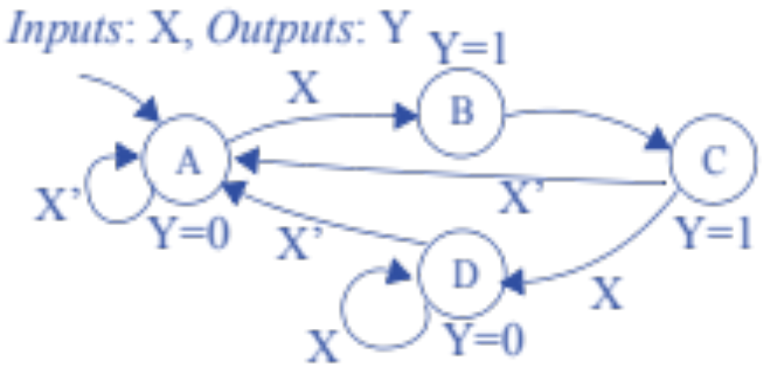
FSM with Input Example
Input: X
Output: Y
Behavior:
  Whenever X changes from 0 to 1, Y becomes 1 for 2 clock cycles
  Y always becomes 0 afterwards for at least 1 clock cycle, even if X is still 1

Slide 15
Today’s Objectives
To understand what a finite state machine (FSM) is
To understand how to use an FSM to describe a sequential circuit

Slide 16
Question
Given a sequence of binary digits, what does the following FSM detect?
input=0
output=1
X
input=1
input=1
output=0
Y
input=0

